Slide 1
Object Oriented Programming CS F213
Dr Pranav M Pawar

Slide 2
Contents
Example of Inheritance (continue from previous lecture)
More example on Inheritance
Types of Inheritance
super keyword in Java
Method Overriding
Overloading vs Overriding
Revision example
Sources ( Slide 2:18)
http://www.cs.loyola.edu/~lawrie/CS630
https://beginnersbook.com/2013/03/inheritance-in-java/
https://www.geeksforgeeks.org/inheritance-in-java/
https://www.programcreek.com/2009/02/overriding-and-overloading-in-java-with-examples/#:~:text=Overloading%20occurs%20when%20two%20or,(i.e.%2C%20method%20signature).
Cay Horstmann, Object Oriented Design & Patterns, John Wiley & Sons, 2006, 2nd Edition

Slide 3
Example of Inheritance (1)
The class diagram for our book example will be,
Book
# pages : int
+ pageMessage() : void
Words
Dictionary
- definitions : int
+ main (args : String[]) : void
+ definitionMessage() : void

Slide 4
Example of Inheritance (2)
//Example 1: Inheritance Example
// base class
class Teacher {
private String designation = "Teacher";
private String collegeName = "Beginnersbook";
public String getDesignation() {
return designation;
}
protected void setDesignation(String designation) {
this.designation = designation;
}
protected String getCollegeName() {
return collegeName;
}
protected void setCollegeName(String collegeName) {
this.collegeName = collegeName;
}
void does(){
System.out.println("Teaching");
}
}

Slide 5
Example of Inheritance (3)
//Example 1: Inheritance Example
// Derived class
public class JavaExample extends Teacher{
String mainSubject = "Physics";
public static void main(String args[]){
JavaExample obj = new JavaExample();
/* Note: we are not accessing the data members
* directly we are using public getter method
* to access the private members of parent class
*/
System.out.println(obj.getCollegeName());
System.out.println(obj.getDesignation());
System.out.println(obj.mainSubject);
obj.does();
}
}

Slide 6
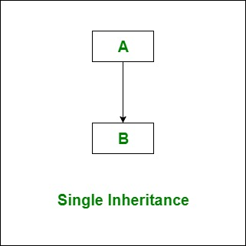
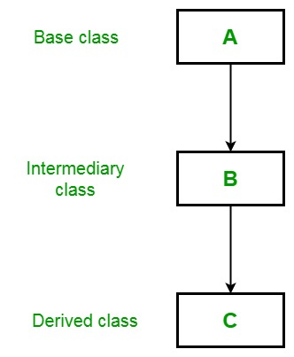
Types of Inheritance
Single Inheritance: Refers to a child and parent class relationship where a class extends the another class.
Multilevel Inheritance: Refers to a child and parent class relationship where a class extends the child class.

Slide 7
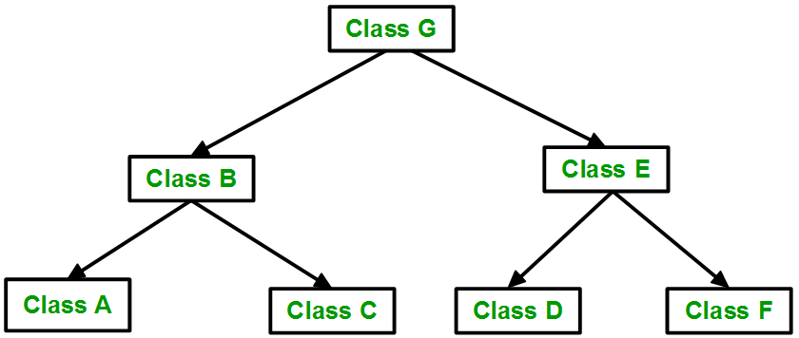
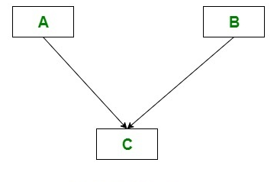
Types of Inheritance
Hierarchical inheritance: Refers to a child and parent class relationship where more than one classes extends the same class.
Multiple Inheritance: Refers to the concept of one class extending more than one classes, which means a child class has two parent classes.

Slide 8
super Keyword in Java (1)
Constructors are not inherited, even though they have public visibility
Yet we often want to use the parent's constructor to set up the "parent's part" of the object
The super reference can be used to refer to the parent class, and often is used to invoke the parent's constructor.
The super reference can also be used to reference other variables and methods defined in the parent’s class.

Slide 9
super Keyword in Java (2)
//Example 2: Use of super with constructors
class Person
{
Person()
{
System.out.println("Person class Constructor");
}
}
/* subclass Student extending the Person class */
class Student extends Person
{
Student()
{ // invoke or call parent class constructor
super();
System.out.println("Student class Constructor");
}
}
/* Driver program to test*/
class Test
{
public static void main(String[] args)
{
Student s = new Student();
}
}
Output:
Person class Constructor
Student class Constructor

Slide 10
super Keyword in Java (3)
//Example 3: Use of super with variables
class Vehicle
{
int maxSpeed = 120;
}
/* sub class Car extending vehicle */
class Car extends Vehicle
{
int maxSpeed = 180;
void display()
{
/* print maxSpeed of base class (vehicle) */
System.out.println("Maximum Speed: " + super.maxSpeed);
}
}
class Test
{
public static void main(String[] args)
{
Car small = new Car();
small.display();
}
}
Output:
Maximum Speed: 120

Slide 11
super Keyword in Java (4)
//Example 4: Use of super with methods
class Person
{
void message()
{ System.out.println("This is person class"); }
}
/* Subclass Student */
class Student extends Person
{
void message()
{ System.out.println("This is student class"); }
// Note that display() is only in Student class
void display()
{
// will invoke or call current class message() method
message();
// will invoke or call parent class message() method
super.message();
}
}
/* Driver program to test */
class Test
{
public static void main(String args[])
{
Student s = new Student();
// calling display() of Student
s.display();
}
}
Output:
This is student class
This is person class

Slide 12
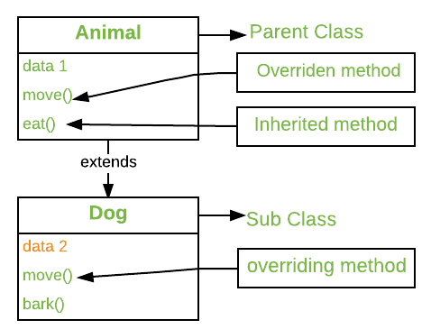
Method Overriding
It allows a subclass or child class to provide a specific implementation of a method that is already provided by one of its super-classes or parent classes.
A child class can override the definition of an inherited method in favour of its own.
The new method must have the same signature as the parent's method, but can have a different body.
The type of the object executing the method determines which version of the method is invoked.

Slide 13
Method Overriding Example 1 (1)
//Example 5: Method overriding example
class Thought
{
public void message()
{ System.out.println ("I feel like I'm diagonally parked" + " in a parallel universe.");
System.out.println();
}
}
public class Advice extends Thought
{
// This method overrides the parent's version.
public void message()
{ System.out.println ("Warning: Dates in calendar are " + "closer than they appear.");
System.out.println();
super.message(); // explicitly invokes the parent's
// version
}
}
public class Messages
{
public static void main (String[] args)
{
Thought parked = new Thought();
Advice dates = new Advice();
parked.message();
dates.message(); // overridden
}
}
}
Output:
I feel like I'm diagonally parked in a parallel universe.
Warning: Dates in calendar are closer than they appear.
I feel like I'm diagonally parked in a parallel universe.

Slide 14
Method Overriding Example 2 (2)
//Example 6 : Method overriding example
// Base Class
class Parent {
void show()
{
System.out.println("Parent's show()");
}
}
// Inherited class
class Child extends Parent {
// This method overrides show() of Parent
@Override
void show()
{
System.out.println("Child's show()");
}
}
// Driver class
class Main {
public static void main(String[] args)
{
// If a Parent type reference refers
// to a Parent object, then Parent's
// show is called
Parent obj1 = new Parent();
obj1.show();
// If a Parent type reference refers
// to a Child object Child's show()
// is called. This is called RUN TIME
// POLYMORPHISM.
Parent obj2 = new Child();
obj2.show();
}
}
Output:
Parent's show()
Child's show()

Slide 15
Method Overriding
Important points to note
Be careful during use of access modifier for overridden methods and variables.
Final methods can not be overridden.
Static methods can not be overridden.
Private methods can not be overridden.
//Example 7: Final method overriding
class Parent {
// Can't be overridden
final void show() {}
}
class Child extends Parent {
// This would produce error
void show() {}
}
Output:
13: error: show() in Child cannot override show() in Parent
void show() { }
^
overridden method is final

Slide 16
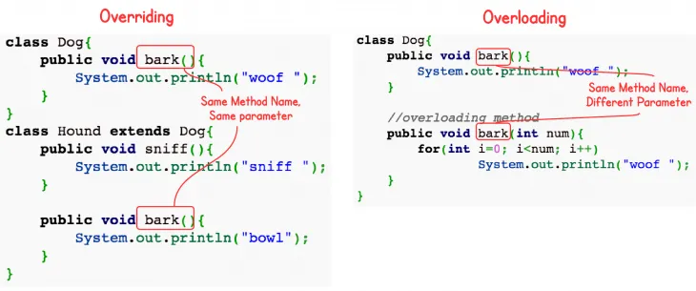
Overloading vs Overriding
Overloading deals with multiple methods with the same name in the same class, but with different signatures
Overriding deals with two methods, one in a parent class and one in a child class, that have the same signature
Overloading lets you define a similar operation in different ways for different parameters
Overriding lets you define a similar operation in different ways for different object types

Slide 17
Revision Example
//Example 8: Revision example
class Bicycle
{ // the Bicycle class has two fields
public int gear;
public int speed;
// the Bicycle class has one constructor
public Bicycle(int gear, int speed)
{ this.gear = gear; this.speed = speed; }
// the Bicycle class has three methods
public void applyBrake(int decrement)
{ speed -= decrement; }
}
public void speedUp(int increment)
{ speed += increment;
}
// toString() method to print info of Bicycle
public String toString()
{
return("No of gears are "+gear +"\n“ + "speed of bicycle is "+speed);
} }

Slide 18
Revision Example
class MountainBike extends Bicycle
{ // the MountainBike subclass adds one more field
public int seatHeight;
// the MountainBike subclass has one constructor
public MountainBike(int gear,int speed,
int startHeight)
{
// invoking base-class(Bicycle) constructor
super(gear, speed);
seatHeight = startHeight;
}
// the MountainBike subclass adds one more method
public void setHeight(int newValue)
{ seatHeight = newValue; }
// overriding toString() method
// of Bicycle to print more info
@Override
public String toString()
{ return (super.toString()+
"\nseat height is "+seatHeight);
} }
// driver class
public class Test
{
public static void main(String args[])
{
MountainBike mb = new MountainBike(3, 100, 25);
System.out.println(mb.toString());
}
}
Output:
No of gears are 3
speed of bicycle is 100
seat height is 25

Slide 19
Thank You!

